Slide 1

Lecture 5: Parallel Tools Landscape – Part 2
Allen D. Malony
Department of Computer and Information Science

Slide 2
Performance and Debugging Tools
Performance Measurement and Analysis:
Open|SpeedShop
HPCToolkit
Vampir
Scalasca
Periscope
mpiP
Paraver
PerfExpert
Modeling and prediction
Prophesy
MuMMI
Autotuning Frameworks
Active Harmony
Orio and Pbound
Debugging
Stat

Slide 3

Periscope
Michael Gerndt
Technische Universität München (Germany)
http://www.lrr.in.tum.de/~periscope

Slide 4
Periscope
Automated profile-based performance analysis
Iterative on-line performance analysis
Multiple distributed hierarchical agents
Automatic search for bottlenecks based on properties formalizing expert knowledge
MPI wait states, OpenMP overheads and imbalances
Processor utilization hardware counters
Clustering of processes/threads with similar properties
Eclipse-based integrated environment
Supports
SGI Altix Itanium2, IBM Power and x86-based architectures
Developed by TU Munich
Released as open-source

Slide 5
Periscope Properties and Strategies
MPI
Excessive MPI communication time
Excessive MPI time due to many small messages
Excessive MPI time in receive due to late sender
…
OpenMP
Load imbalance in parallel region/section
Sequential computation in master/single/ordered region
...
Hardware performance counters (platform-specific)
Cycles lost due to cache misses
high L1/L2/L3 demand load miss rate
Cycles lost due to no instruction to dispatch
...

Slide 6
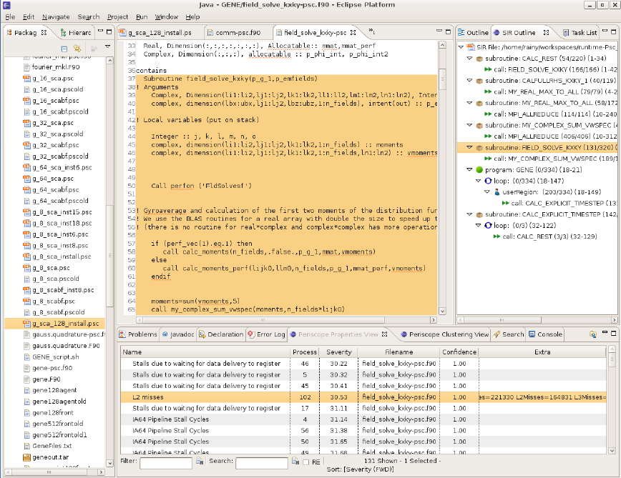
Periscope Plug-in to Eclipse Environment
Source code view
SIR outline view
Project view
Properties view

Slide 7
Benchmark Instrumentation
Instrumentation, either manually or using Score-P
Change compiler to Score-P wrapper script
Compile and link

Slide 8
Periscope Online Analysis
Periscope is started via its frontend and automatically starts application and hierarchy of analysis agents
% psc_frontend --help
Usage: psc_frontend <options>
[--help] (displays this help message)
[--quiet] (do not display debug messages)
[--registry=host:port] (address of the registry service, optional)
[--port=n] (local port number, optional)
[--maxfan=n] (max. number of child agents, default=4)
[--timeout=secs] (timeout for startup of agent hierarchy)
[--delay=n] (search delay in phase executions)
[--appname=name]
[--apprun=commandline]
[--mpinumprocs=number of MPI processes]
[--ompnumthreads=number of OpenMP threads]
…
[--strategy=name]
[--sir=name]
[--phase=(FileID,RFL)]
[--debug=level]

Slide 9
Periscope Online Analysis Strategies
Experiment with strategies
Strategies: MPI, OMP, scalability_OMP
Experiment with OpenMP thread counts
livetau$ psc_frontend --apprun=./bt-mz_B.4 --strategy=MPI
--mpinumprocs=4 –ompnumthreads=1 –phase=“OA_phase”
[psc_frontend][DBG0:fe] Agent network UP and RUNNING. Starting search.
NAS Parallel Benchmarks 3.3 -- BT Benchmark
[...]
Time step 200
BT Benchmark Completed.
----------
End Periscope run! Search took 60.5 seconds (33.3 seconds for startup)

Slide 10
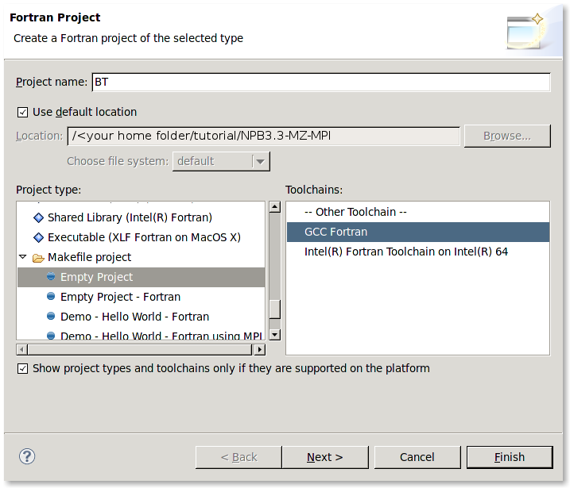
Creating Fortran Project
File->New->Project... → Fortran->Fortran Project
Input
project
name
Unmark
“Use default
location”
and provide path to BT folder
Project
type
Press
Finish

Slide 11
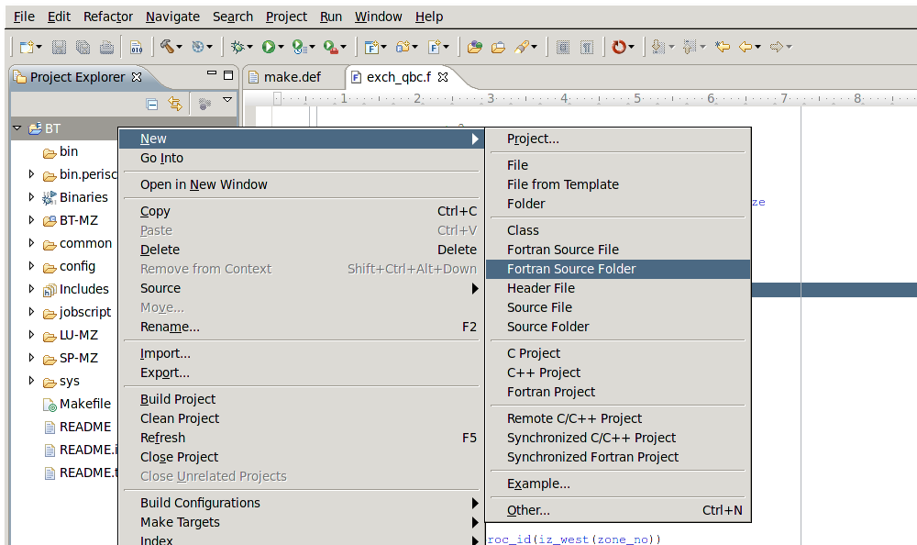
Add BT-MZ as a Source Folder
Right-click -> File-> New -> Fortran Source Folder

Slide 12
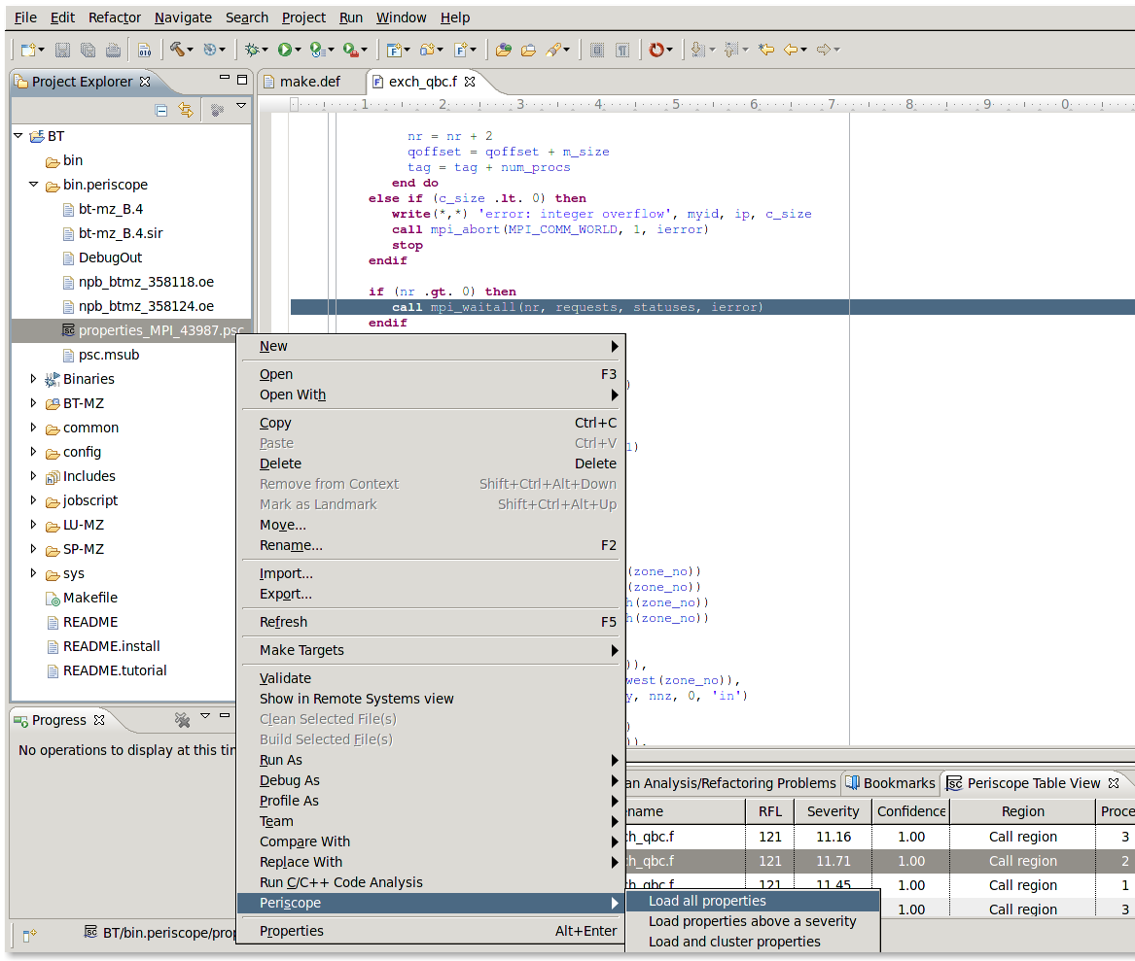
Loading Properties
Expand BT project,
search for *.psc
and
Right click->Periscope->
Load all properties

Slide 13
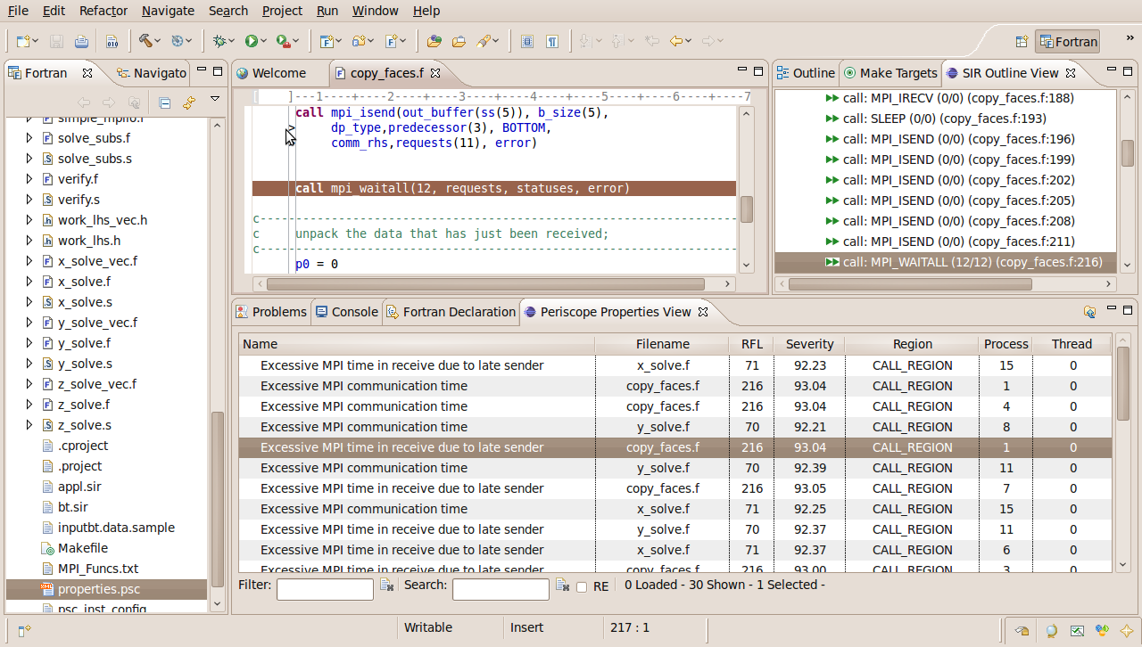
Periscope GUI
SIR outline view
Project explorer
view
Source code
view
Periscope properties
view

Slide 14
Periscope GUI Report Exploration Features
Multi-functional table is used in the GUI for Eclipse for the visualization of bottlenecks
Multiple criteria sorting algorithm
Complex categorization utility
Searching engine using Regular Expressions
Filtering operations
Direct navigation from the bottlenecks to their precise source location using the default IDE editor for that source file type (e.g. CDT/Photran editor).
SIR outline view shows a combination of the standard intermediate representation (SIR) of the analysed application and the distribution of its bottlenecks. The main goals of this view are to assist the navigation in the source code and attract developer's attention to the most problematic code areas.

Slide 15
Periscope GUI Report Exploration Features
Multi-functional table is used in the GUI for Eclipse for the visualization of bottlenecks
Multiple criteria sorting algorithm
Complex categorization utility
Searching engine using Regular Expressions
Filtering operations
Direct navigation from the bottlenecks to their precise source location using the default IDE editor for that source file type (e.g. CDT/Photran editor)
SIR outline view shows a combination of the standard intermediate representation (SIR) of the analysed application and the distribution of its bottlenecks
Main goals of this view are to assist the navigation in the source code and attract developer's attention to the most problematic code areas.

Slide 16
Properties Clustering
Clustering can effectively summarize displayed properties and identify a similar performance behaviour possibly hidden in the large amount of data
Right-click->
Cluster properties by type

Slide 17
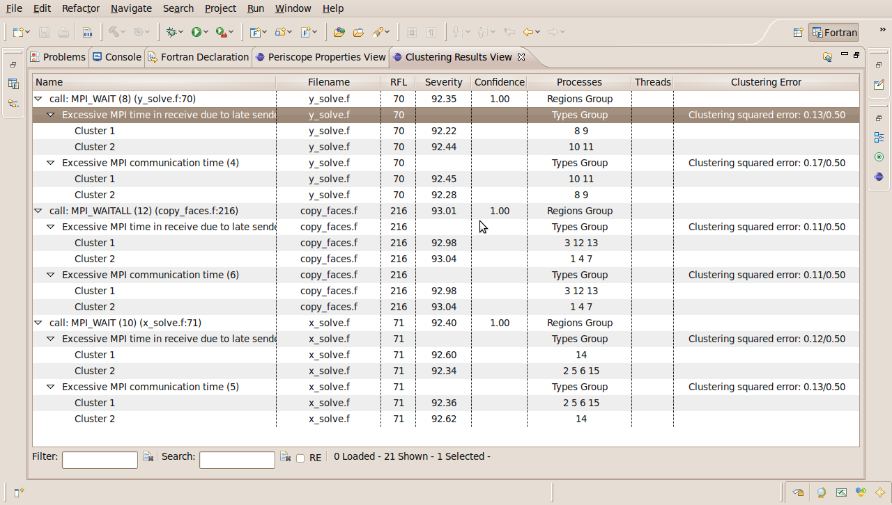
Properties Clustering
Severity value
of the Cluster 1
Region and property
where clustering performed
Processes belonging
To the Cluster1

Slide 18
mpiP: Lightweight, Scalable MPI Profiling
Jeff Vetter
Oak Ridge National Laboratory (USA)
http://mpip.sourceforge.net

Slide 19
So, You Need to Look at a New Application …
Scenarios
New application development
Analyze/Optimize external application
Suspected bottlenecks
First goal is an overview of …
Communication frequency and intensity
Types and complexity of communication
Source code locations of expensive MPI calls
Differences between processes

Slide 20
Basic Principle of Profiling MPI
Intercept all MPI API calls
Using wrappers for all MPI calls
Aggregate statistics over time
Number of invocations
Data volume
Time spent during function execution
Multiple aggregations options/granularity
By function name or type
By source code location (call stack)
By process rank

Slide 21
mpiP: Efficient MPI Profiling
Open source MPI profiling library
Developed at LLNL, maintained by LLNL & ORNL
Available from sourceforge
Works with any MPI library
Easy-to-use and portable design
Relies on PMPI instrumentation
No additional tool daemons or support infrastructure
Single text file as output
Optional: GUI viewer

Slide 22
Running with mpiP 101 / Experimental Setup
mpiP works on binary files
Uses standard development chain
Use of “-g” recommended
Run option 1: Relink
Specify libmpi.a/.so on the link line
Portable solution, but requires object files
Run option 2: library preload
Set preload variable (e.g., LD_PRELOAD) to mpiP
Transparent, but only on supported systems

Slide 23
Running with mpiP 101 / Running
bash-3.2$ srun –n4 smg2000
mpiP:
mpiP:
mpiP: mpiP V3.1.2 (Build Dec 16 2008/17:31:26)
mpiP: Direct questions and errors to mpip-help@lists.sourceforge.net
mpiP:
Running with these driver parameters:
(nx, ny, nz) = (60, 60, 60)
(Px, Py, Pz) = (4, 1, 1)
(bx, by, bz) = (1, 1, 1)
(cx, cy, cz) = (1.000000, 1.000000, 1.000000)
(n_pre, n_post) = (1, 1)
dim = 3
solver ID = 0
=============================================
Struct Interface:
=============================================
Struct Interface:
wall clock time = 0.075800 seconds
cpu clock time = 0.080000 seconds
Header
=============================================
Setup phase times:
=============================================
SMG Setup:
wall clock time = 1.473074 seconds
cpu clock time = 1.470000 seconds
=============================================
Solve phase times:
=============================================
SMG Solve:
wall clock time = 8.176930 seconds
cpu clock time = 8.180000 seconds
Iterations = 7
Final Relative Residual Norm = 1.459319e-07
mpiP:
mpiP: Storing mpiP output in [./smg2000-p.4.11612.1.mpiP].
mpiP:
bash-3.2$
Output File

Slide 24
mpiP 101 / Output – Metadata
@ mpiP
@ Command : ./smg2000-p -n 60 60 60
@ Version : 3.1.2
@ MPIP Build date : Dec 16 2008, 17:31:26
@ Start time : 2009 09 19 20:38:50
@ Stop time : 2009 09 19 20:39:00
@ Timer Used : gettimeofday
@ MPIP env var : [null]
@ Collector Rank : 0
@ Collector PID : 11612
@ Final Output Dir : .
@ Report generation : Collective
@ MPI Task Assignment : 0 hera27
@ MPI Task Assignment : 1 hera27
@ MPI Task Assignment : 2 hera31
@ MPI Task Assignment : 3 hera31

Slide 25
mpiP 101 / Output – Overview
------------------------------------------------------------
@--- MPI Time (seconds) ------------------------------------
------------------------------------------------------------
Task AppTime MPITime MPI%
0 9.78 1.97 20.12
1 9.8 1.95 19.93
2 9.8 1.87 19.12
3 9.77 2.15 21.99
* 39.1 7.94 20.29
-----------------------------------------------------------

Slide 26
mpiP 101 / Output – Callsites
---------------------------------------------------------------------------
@--- Callsites: 23 --------------------------------------------------------
---------------------------------------------------------------------------
ID Lev File/Address Line Parent_Funct MPI_Call
1 0 communication.c 1405 hypre_CommPkgUnCommit Type_free
2 0 timing.c 419 hypre_PrintTiming Allreduce
3 0 communication.c 492 hypre_InitializeCommunication Isend
4 0 struct_innerprod.c 107 hypre_StructInnerProd Allreduce
5 0 timing.c 421 hypre_PrintTiming Allreduce
6 0 coarsen.c 542 hypre_StructCoarsen Waitall
7 0 coarsen.c 534 hypre_StructCoarsen Isend
8 0 communication.c 1552 hypre_CommTypeEntryBuildMPI Type_free
9 0 communication.c 1491 hypre_CommTypeBuildMPI Type_free
10 0 communication.c 667 hypre_FinalizeCommunication Waitall
11 0 smg2000.c 231 main Barrier
12 0 coarsen.c 491 hypre_StructCoarsen Waitall
13 0 coarsen.c 551 hypre_StructCoarsen Waitall
14 0 coarsen.c 509 hypre_StructCoarsen Irecv
15 0 communication.c 1561 hypre_CommTypeEntryBuildMPI Type_free
16 0 struct_grid.c 366 hypre_GatherAllBoxes Allgather
17 0 communication.c 1487 hypre_CommTypeBuildMPI Type_commit
18 0 coarsen.c 497 hypre_StructCoarsen Waitall
19 0 coarsen.c 469 hypre_StructCoarsen Irecv
20 0 communication.c 1413 hypre_CommPkgUnCommit Type_free
21 0 coarsen.c 483 hypre_StructCoarsen Isend
22 0 struct_grid.c 395 hypre_GatherAllBoxes Allgatherv
23 0 communication.c 485 hypre_InitializeCommunication Irecv
---------------------------------------------------------------------------

Slide 27
mpiP 101 / Output – per Function Timing
--------------------------------------------------------------
@--- Aggregate Time (top twenty, descending, milliseconds) ---
--------------------------------------------------------------
Call Site Time App% MPI% COV
Waitall 10 4.4e+03 11.24 55.40 0.32
Isend 3 1.69e+03 4.31 21.24 0.34
Irecv 23 980 2.50 12.34 0.36
Waitall 12 137 0.35 1.72 0.71
Type_commit 17 103 0.26 1.29 0.36
Type_free 9 99.4 0.25 1.25 0.36
Waitall 6 81.7 0.21 1.03 0.70
Type_free 15 79.3 0.20 1.00 0.36
Type_free 1 67.9 0.17 0.85 0.35
Type_free 20 63.8 0.16 0.80 0.35
Isend 21 57 0.15 0.72 0.20
Isend 7 48.6 0.12 0.61 0.37
Type_free 8 29.3 0.07 0.37 0.37
Irecv 19 27.8 0.07 0.35 0.32
Irecv 14 25.8 0.07 0.32 0.34
...

Slide 28
mpiP Output – per Function Message Size
-----------------------------------------------------------------------
@--- Aggregate Sent Message Size (top twenty, descending, bytes) ------
-----------------------------------------------------------------------
Call Site Count Total Avrg Sent%
Isend 3 260044 2.3e+08 885 99.63
Isend 7 9120 8.22e+05 90.1 0.36
Isend 21 9120 3.65e+04 4 0.02
Allreduce 4 36 288 8 0.00
Allgatherv 22 4 112 28 0.00
Allreduce 2 12 96 8 0.00
Allreduce 5 12 96 8 0.00
Allgather 16 4 16 4 0.00

Slide 29
mpiP 101 / Output – per Callsite Timing
---------------------------------------------------------------------------
@--- Callsite Time statistics (all, milliseconds): 92 ---------------------
---------------------------------------------------------------------------
Name Site Rank Count Max Mean Min App% MPI%
Allgather 16 0 1 0.034 0.034 0.034 0.00 0.00
Allgather 16 1 1 0.049 0.049 0.049 0.00 0.00
Allgather 16 2 1 2.92 2.92 2.92 0.03 0.16
Allgather 16 3 1 3 3 3 0.03 0.14
Allgather 16 * 4 3 1.5 0.034 0.02 0.08
Allgatherv 22 0 1 0.03 0.03 0.03 0.00 0.00
Allgatherv 22 1 1 0.036 0.036 0.036 0.00 0.00
Allgatherv 22 2 1 0.022 0.022 0.022 0.00 0.00
Allgatherv 22 3 1 0.022 0.022 0.022 0.00 0.00
Allgatherv 22 * 4 0.036 0.0275 0.022 0.00 0.00
Allreduce 2 0 3 0.382 0.239 0.011 0.01 0.04
Allreduce 2 1 3 0.31 0.148 0.046 0.00 0.02
Allreduce 2 2 3 0.411 0.178 0.062 0.01 0.03
Allreduce 2 3 3 1.33 0.622 0.062 0.02 0.09
Allreduce 2 * 12 1.33 0.297 0.011 0.01 0.04
...

Slide 30
mpiP 101 / Output – per Callsite Message Size
---------------------------------------------------------------------------
@--- Callsite Message Sent statistics (all, sent bytes) -------------------
---------------------------------------------------------------------------
Name Site Rank Count Max Mean Min Sum
Allgather 16 0 1 4 4 4 4
Allgather 16 1 1 4 4 4 4
Allgather 16 2 1 4 4 4 4
Allgather 16 3 1 4 4 4 4
Allgather 16 * 4 4 4 4 16
Allgatherv 22 0 1 28 28 28 28
Allgatherv 22 1 1 28 28 28 28
Allgatherv 22 2 1 28 28 28 28
Allgatherv 22 3 1 28 28 28 28
Allgatherv 22 * 4 28 28 28 112
Allreduce 2 0 3 8 8 8 24
Allreduce 2 1 3 8 8 8 24
Allreduce 2 2 3 8 8 8 24
Allreduce 2 3 3 8 8 8 24
Allreduce 2 * 12 8 8 8 96
...

Slide 31
Fine Tuning the Profile Run
mpiP Advanced Features
User controlled stack trace depth
Reduced output for large scale experiments
Application control to limit scope
Measurements for MPI I/O routines
Controlled by MPIP environment variable
Set by user before profile run
Command line style argument list

Slide 32
mpiP Parameters
Param. | Description | Default
-c | Concise Output / No callsite data
-f dir | Set output directory
-k n | Set callsite stack traceback size to n | 1
-l | Use less memory for data collection
-n | Do not truncate pathnames
-o | Disable profiling at startup
-s n | Set hash table size | 256
-t x | Print threshold | 0.0
-v | Print concise & verbose output

Slide 33
Controlling the Stack Trace
Callsites are determined using stack traces
Starting from current call stack going backwards
Useful to avoid MPI wrappers
Helps to distinguishes library invocations
Tradeoff: stack trace depth
Too short: can’t distinguish invocations
Too long: extra overhead / too many call sites
User can set stack trace depth

Slide 34
Platforms
Highly portable design
Built on top of PMPI, which is part of any MPI
Very few dependencies
Tested on many platforms, including
Linux (x86, x86-64, IA-64, MIPS64)
BG/L & BG/P
AIX (Power 3/4/5)
Cray XT3/4/5 with Catamount and CNL
Cray X1E

Slide 35
mpiPView: The GUI for mpiP
Optional: displaying mpiP data in a GUI
Implemented as part of the Tool Gear project
Reads mpiP output file
Provides connection to source files
Usage process
First: select input metrics
Hierarchical view of all callsites
Source panel once callsite is selected
Ability to remap source directories

Slide 36
Paraver
Jesus Labarta
Barcelona Supercomputing Center (Spain)
http://www.bsc.es/paraver

Slide 37
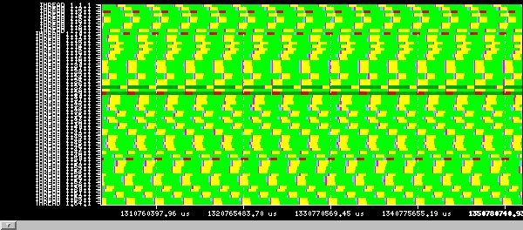
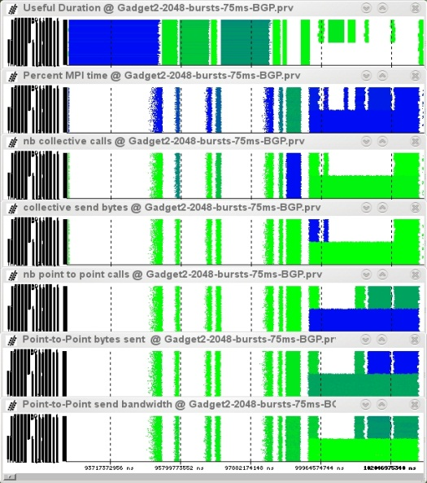
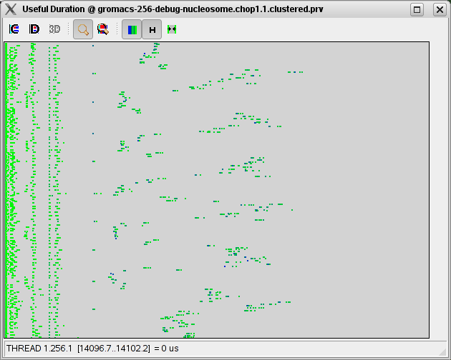
BSC Tools
Since 1991
Based on traces
Open Source
http://www.bsc.es/paraver
Core tools:
Paraver (paramedir) – offline trace analysis
Dimemas – message passing simulator
Extrae – instrumentation
Focus
Detail, flexibility, intelligence

Slide 38
Extrae
Major BSC instrumentation package
When / where
Parallel programming model runtime
MPI, OpenMP, pthreads, OmpSs, CUDA, OpenCL, MIC…
API entry/exit, OpenMP outlined routines
Selected user functions
Periodic samples
User events
Additional information
Counters
PAPI
Network counters
OS counters
Link to source code
Callstack
Notes:
Read what Extrae can instrument.
* Counters, frequently like PAPI or at some points like network counters or OS counters.
* As opposite to other tools, we default to no instrument user functions because we are confident that callstack at MPI calls provides a good initial insight to study the application.

Slide 39
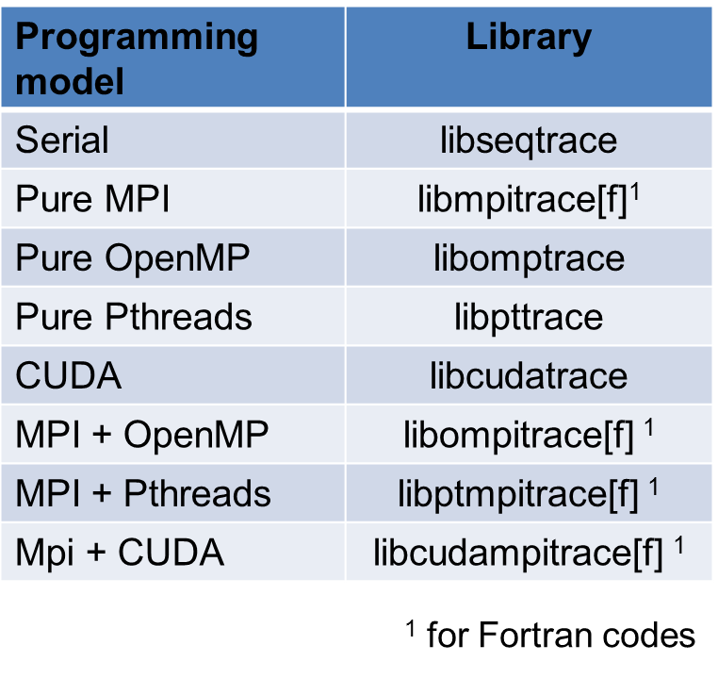
How does Extrae intercept your app?
LD_PRELOAD
Works on production binaries
Specific library for each combination of runtimes
Does not require knowledge on the application
Dynamic instrumentation
Works on production binaries (based on Dyninst)
Just specify functions to be instrumented.
Other possibilities
Link instrumentation library statically
OmpSs (instrumentation calls injected by compiler + linked to library)
Notes:
How does Extrae work?
Extrae basically injects monitor into the application. There are different ways to inject such monitors including DynInst, which modifies the application in memory and using the LD_PRELOAD, which is used to substitute symbols in the shared librarie within the application before it gets executed.
No matter the mechanism chosen we inject monitors that emit information regarding the placement, the timestamp and also additional metrics like performance counters or the callstack.
Hacer que escojan una para el hands-on.

Slide 40
How to use Extrae?
Adapt job submission script
Specify LD_PRELOAD library and xml instrumentation control file
Specify the data to be captured in the .xml instrumentation control file
Run and get the trace …
Notes:
Using Extrae is rather simple. You should just to adapt your job submission script. This involves telling the launcher to execute Extrae in front of the target application and passing a configuration file for Extrae. Once this is done, you only need to run the application normally.

Slide 41
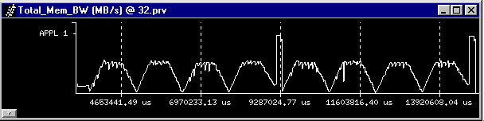
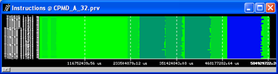
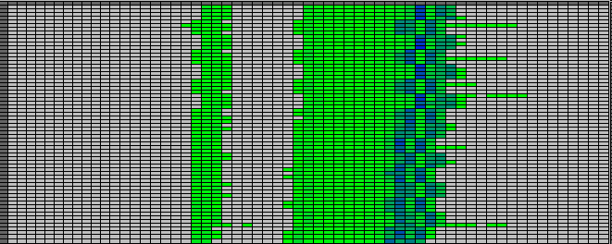
Paraver Performance Data Browser
Trace visualization/analysis
Raw data
+ trace manipulation
Timelines
Goal = Flexibility
No semantics
Programmable
2/3D tables (Statistics)
Comparative analyses
Multiple traces
Synchronize scales
Notes:
We present an alternative to deal with the traces scalability problem. Nowadays, is not surprising to have 10k processes that run for hours. Quickly evolving to the Petascale.
Blind tracing produces huge data volumes.
Even profilers can face scalability issues.
Once you try to gather such data volume, the first question is... can you store it?
Even if you can, the amount of time required to parse/process/manipulate that can be high. If the tool is not responsive enough, what's the acceptable amount of time for you to wait?

Slide 42
Paraver Mathematical Foundation
Every behavioral aspect/metric described as a function of time
Possibly aggregated along
the process model dimension (thread, process, application, workload)
The resource model dimension (core, node, system)
Language to describe how to compute such functions of time (GUI)
Basic operators (from) trace records
Ways of combining them
Those functions of time can be rendered into a 2D image
Timeline
Statistics can be computed for each possible value or range of values of that function of time
Tables: profiles and histograms

Slide 43
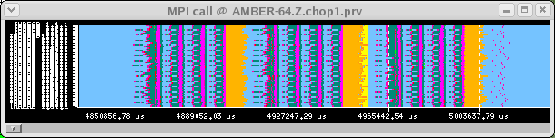
Paraver Mathematical Foundation
Function of time
Series of values
Trace
Filter
Sub-Trace / subset of records
Semantic
(S₁,t₁), (S₂,t₂), (S₃,t₃),…
Display

Slide 44
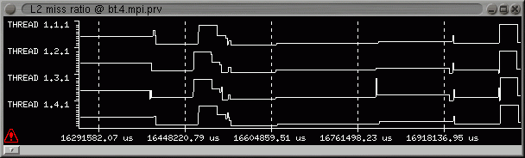
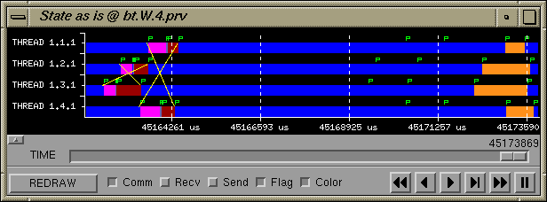
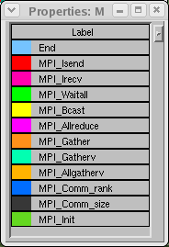
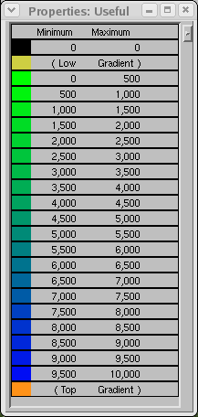
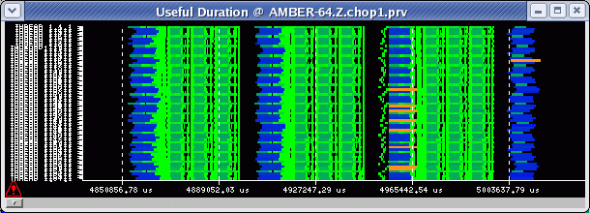
Timelines
Representation
Function of time
Colour encoding
Not null gradient
Black for zero value
Light green → Dark blue
Non linear rendering to address scalability
J. Labarta, et al.: “Scalability of tracing and visualization tools”, PARCO 2005

Slide 45
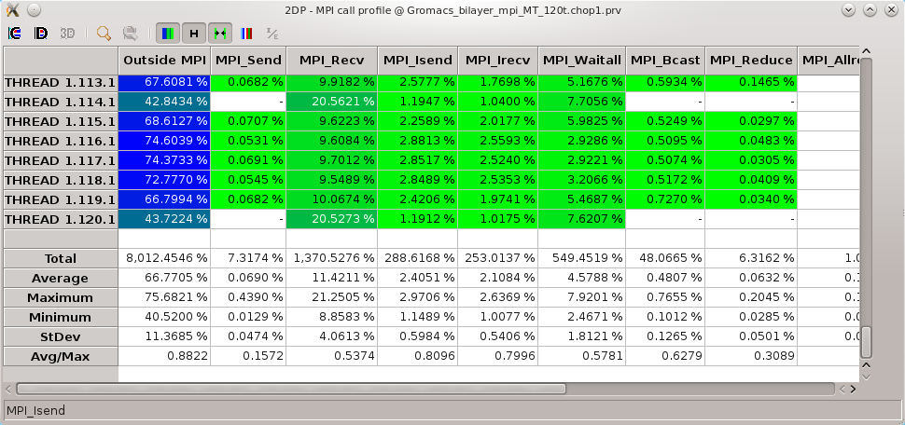
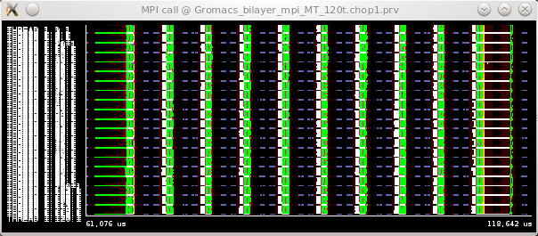
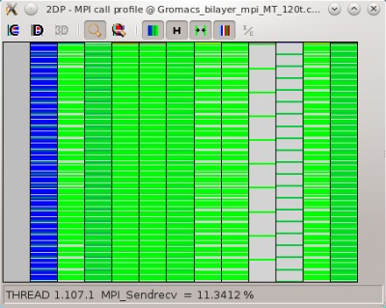
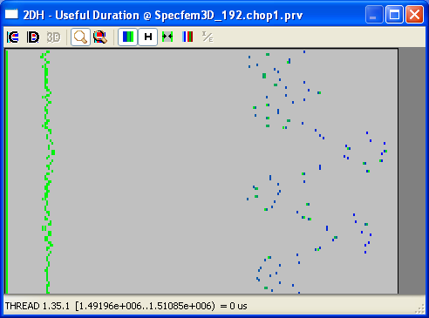
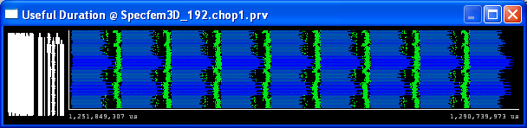
Tables: Profiles, histograms, correlations
From timelines to tables
MPI calls profile
MPI calls
Histogram Useful Duration
Useful Duration

Slide 46
Dimemas: Coarse grain, Trace driven simulation
Simulation: Highly non linear model
Linear components
Point to point communication
Sequential processor performance
Global CPU speed
Per block/subroutine
Non linear components
Synchronization semantics
Blocking receives
Rendezvous
Resource contention
CPU
Communication subsystem
links (half/full duplex), busses
B
L
L
L
CPU
Local
CPU
Local
CPU
Local
CPU
Memory
CPU
Memory
CPU
Memory
CPU
CPU
CPU

Slide 47
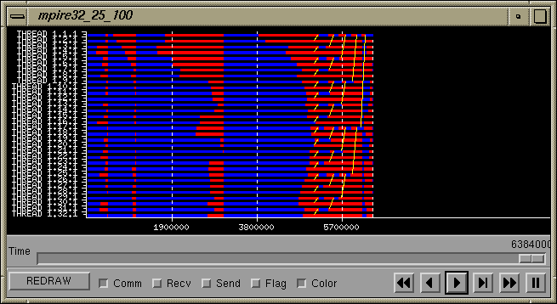
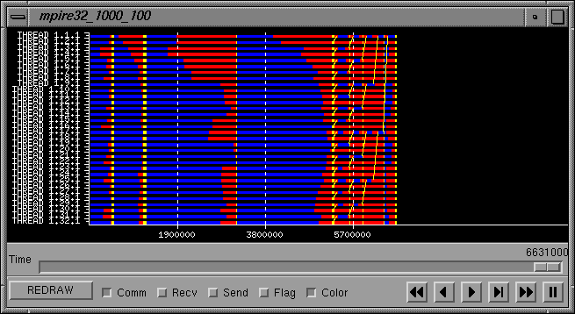
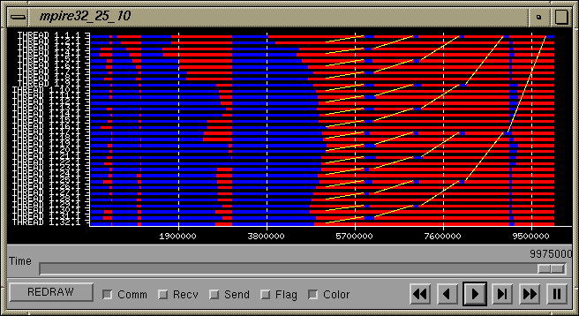
MPIRE 32 tasks, no network contention
Are all parts of an app. equally sensitive to network?
L=25us, BW=100MB/s
L=1000us, BW=100MB/s
All windows same scale
L=25us, BW=10MB/s
Notes:
We present an alternative to deal with the traces scalability problem. Nowadays, is not surprising to have 10k processes that run for hours. Quickly evolving to the Petascale.
Blind tracing produces huge data volumes.
Even profilers can face scalability issues.
Once you try to gather such data volume, the first question is... can you store it?
Even if you can, the amount of time required to parse/process/manipulate that can be high. If the tool is not responsive enough, what's the acceptable amount of time for you to wait?

Slide 48
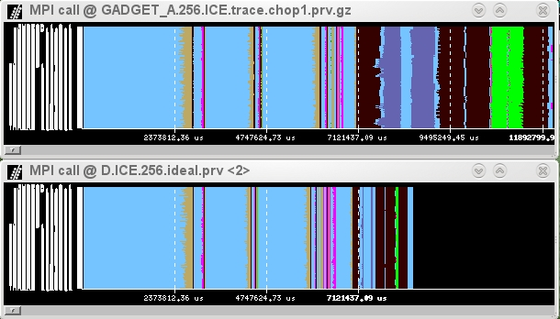

Ideal Machine
The impossible machine: BW = ∞, L = 0
Actually describes/characterizes Intrinsic application behavior
Load balance problems?
Dependence problems?
GADGET @ Nehalem cluster
256 processes
Allgather
+
sendrecv
alltoall
allreduce
sendrec
waitall
Real
run
Impact on practical machines?
Ideal
network

Slide 49

Prophesy / MuMMI
Valerie Taylor
Texas A&M University (USA)
Argonne National Laboratory (USA)
http://prophesy.cs.tamu.edu

Slide 50
Prophesy
Infrastructure for analyzing and modeling the performance of parallel and distributed applications
Relational database with:
performance data
system features
application details
System can be used to
Develop models based upon significant data
Identify the most efficient implementation of a given function based upon the given system configuration
Explore the various trends implicated by the significant data
Predict the performance on a different system

Slide 51
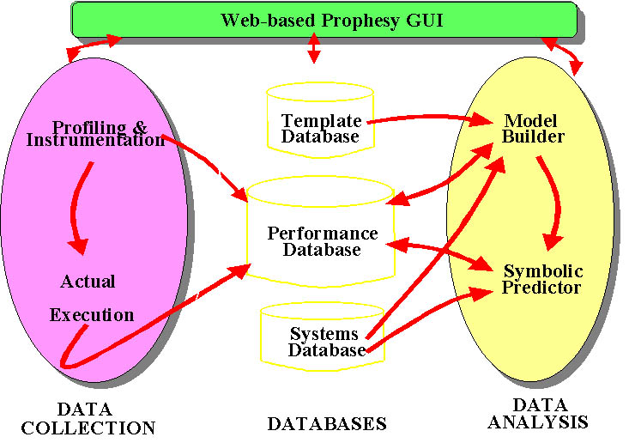
Prophesy Architecture

Slide 52
Prophesy Workflow
Application is instrumented, executed, data is automatically transferred to Prophesy database
Prophesy generates an analytical model with coefficients based on performance data, system data and model templates
All web-enabled
Linear / non-linear models used to:
Predict performance on new compute platform
Experiment with system feature modifications

Slide 53
MuMMI
The Multiple Metrics Modeling Infrastructure (MuMMI) project
An infrastructure for analyzing and modeling the performance and power consumption of parallel and distributed applications
http://www.mummi.org
MuMMI allows for the development of linear as well as nonlinear models
Models, when combined with data from the system database, can be used by the prediction engine to predict the performance on a different compute platform
Models can give insight into which machine may perform the best for the given implementation of the kernel and what happens when one changes different features of the system

Slide 54
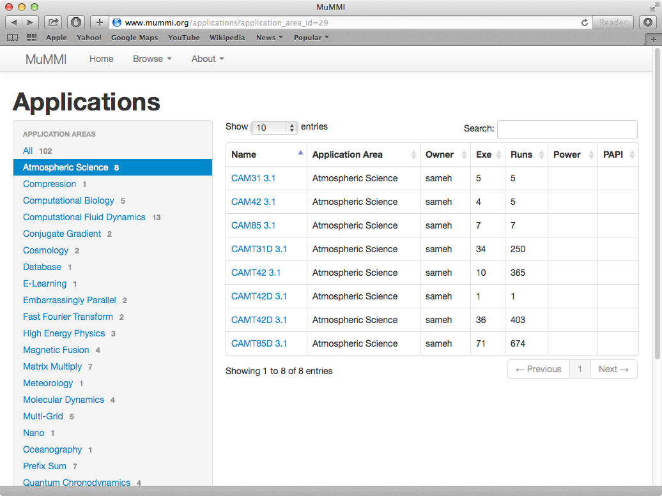
MuMMI Application Browser
List of Applications
Experiment groups

Slide 55
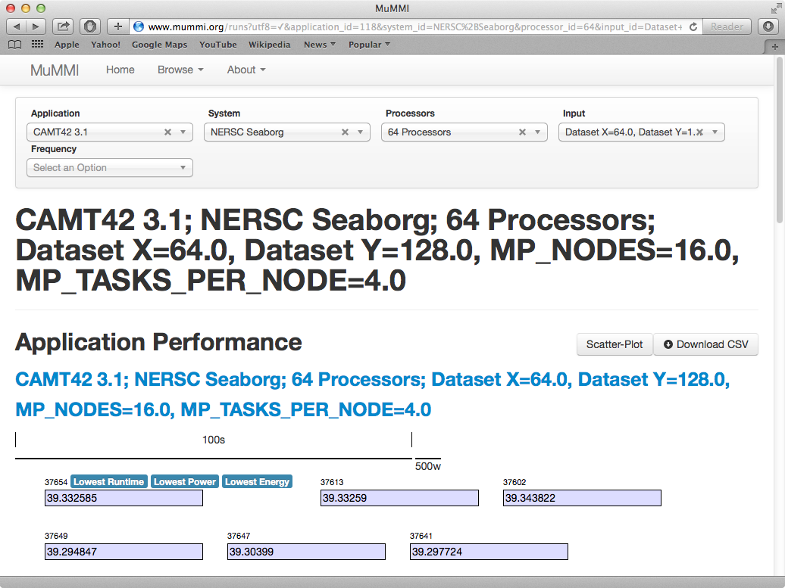
MuMMI Sample Application
Application
System
# Processors
Input Description
Per-node performance results

Slide 56
PerfExpert
Jim Browne
Texas Advanced Computing Center (USA)
University of Texas at Austin (USA)

Slide 57
Goals for PerfExpert
Make use of the tool as simple as possible
Start with only chip/node level optimization
Make it adaptable across multiple architectures
Design for extension to communication and I/O performance
How?
Formulate the performance optimization task as a workflow of tasks
Leverage the state-of-the-art
Automate the entire workflow

Slide 58
PerfExpert: Introduction
Four stages of automatic performance optimization:
Measurement and attribution
Analysis, diagnosis and identification of bottlenecks
Selection of effective optimizations
Implementation of optimizations
Components:
HPCToolkit
MACPO (based on ROSE)
Bison, Flex, PIPS

Slide 59
PerfExpert Performance Report
Identification of bottlenecks by relevance
Performance analysis based on performance metrics
Recommendations for optimization
Three possible outputs:
Performance report only
List of recommendations
Fully automated code transformation

Slide 60
PerfExpert: The Big Picture

Slide 61
PerfExpert: Work Flow Script

Slide 62
PerfExpert: Analyzer

Slide 63
PerfExpert: MACPO

Slide 64
PerfExpert: Optimization Formulator

Slide 65
PerfExpert: Support Database

Slide 66
PerfExpert: Pattern Recognizer

Slide 67
PerfExpert: Transformer

Slide 68
PerfExpert: Integrator

Slide 69
PerfExpert: Key Points for Design
Each piece of the tool chain can be updated/upgraded individually
It is flexible: you can add new metrics as well as plug new tools to measure application performance
It is extendable: new recommendations, transformations and strategies to select recommendations
Multi-language, multi-architecture, open-source and built on top of well-established tools (HPCToolKit, ROSE, PIPS, etc.)
Easy to use and lightweight

Slide 70
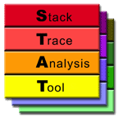
STAT: Stack Trace Analysis Tool
Martin Schulz, Bart Miller, Dorian Arnold
Lawrence Livermore National Laboratory (USA)
University of Wisconsin (USA)
University of New Mexico (USA)

Slide 71

STAT: Aggregating Stack Traces for Debugging
Existing debuggers don’t scale
Inherent limits in the approaches
Need for new, scalable methodologies
Need to pre-analyze and reduce data
Fast tools to gather state
Help select nodes to run conventional debuggers on
Scalable tool: STAT
Stack Trace Analysis Tool
Goal: Identify equivalence classes
Hierarchical and distributed aggregation of stack traces from all tasks
Stack trace merge <1s from 200K+ cores
Notes:
Existing debugging tools are insufficient. LLNL application developers lose substantial productivity (measured in days and weeks) as a result
No one has previously figured out how to do better. Industry is not motivated to solve at extreme scales and spends all of their resources just trying to port existing capabilities to new platforms
We provide an initial paradigm shift by enabling application of existing techniques on a small subset of the cores, reducing the scaling barrier. More importantly, we will build on the mechanisms of this initial shift to create a truly new debugging paradigm that automates the key debugging activities: finding the error in the source code and understanding what type of error it is.

Slide 72
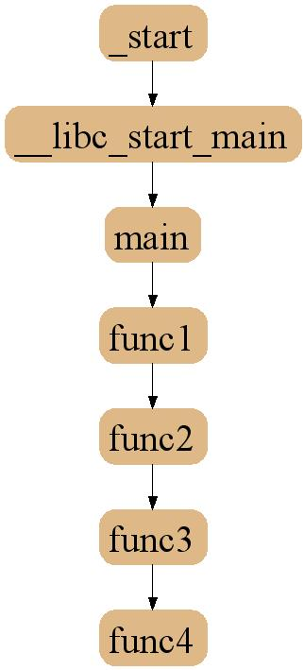
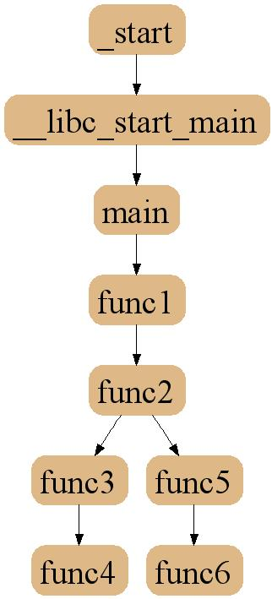

Distinguishing Behavior with Stack Traces

Slide 73
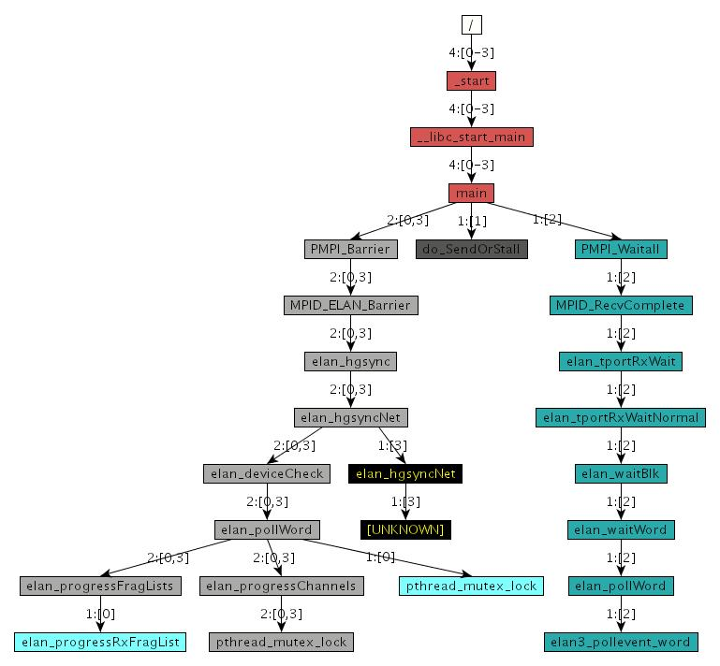
3D-Trace Space/Time Analysis
Appl
Appl
…
Appl
…
Appl
Appl
Notes:
Single sample, multiple processes:
- Loosely synchronized distributed snapshot
- Inconclusive information

Slide 74
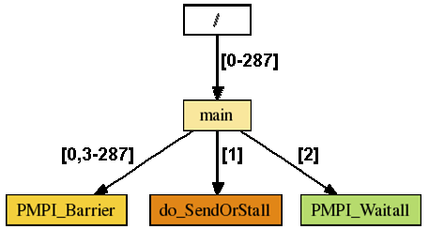
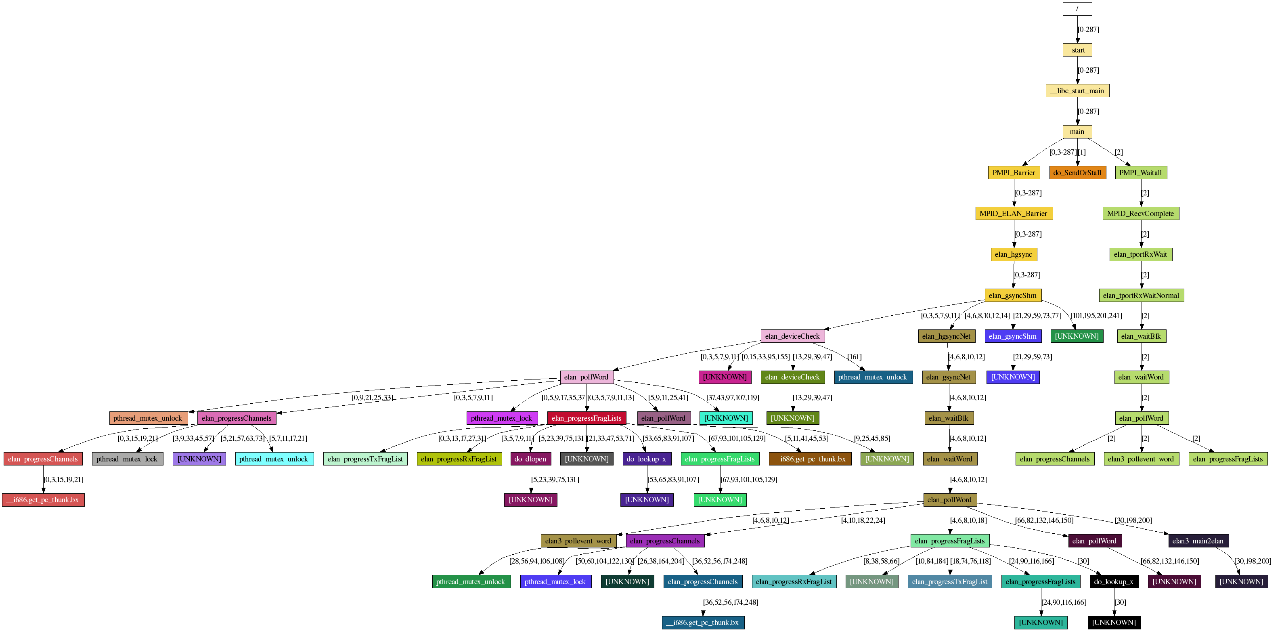
Scalable Representation
288 Nodes / 10 Snapshots

Slide 75

Active Harmony
Jeff Hollingsworth
University of Maryland (USA)
University of Wisconsin (USA)
http://dyninst.org/harmony

Slide 76
Why Automate Performance Tuning?
Too many parameters that impact performance.
Optimal performance for a given system depends on:
Details of the processor
Details of the inputs (workload)
Which nodes are assigned to the program
Other things running on the system
Parameters come from:
User code
Libraries
Compiler choices
Automated Parameter tuning can be used for adaptive tuning in complex software.

Slide 77
Automated Performance Tuning
Goal: Maximize achieved performance
Problems:
Large number of parameters to tune
Shape of objective function unknown
Multiple libraries and coupled applications
Analytical model may not be available
Shape of objective function could change during execution!
Requirements:
Runtime tuning for long running programs
Don’t run too many configurations
Don’t try really bad configurations

Slide 78
I really mean don’t let people hand tune
Example, a dense matrix multiply kernel
Various Options:
Original program: 30.1 sec
Hand Tuned (by developer): 11.4 sec
Auto-tuned of hand-tuned: 15.9 sec
Auto-tuned original program: 8.5 sec
What Happened?
Hand tuning prevented analysis
Auto-tuned transformations were then not possible
Notes:
To solve those problems, we developed the Active Harmony system. The Harmony is a real time performance optimization system. It helps the application to selection the appropriate underlying programming library. That is, it select the “right code” to use. In order to do so, it monitors the performance for all underlying programming libraries. Then during execution, it will switch among those programming libraries if necessary.
After selecting the appropriate underlying programming library, it will also tune the library together with all other parameters. The system monitors the whole system performance and adjust the tunable parameters during runtime.

Slide 79
Active Harmony
Runtime performance optimization
Can also support training runs
Automatic library selection (code)
Monitor library performance
Switch library if necessary
Automatic performance tuning (parameter)
Monitor system performance
Adjust runtime parameters
Hooks for Compiler Frameworks
Integrated with USC/ISI Chill
Notes:
To solve those problems, we developed the Active Harmony system. The Harmony is a real time performance optimization system. It helps the application to selection the appropriate underlying programming library. That is, it select the “right code” to use. In order to do so, it monitors the performance for all underlying programming libraries. Then during execution, it will switch among those programming libraries if necessary.
After selecting the appropriate underlying programming library, it will also tune the library together with all other parameters. The system monitors the whole system performance and adjust the tunable parameters during runtime.

Slide 80
Basic Client API Overview
Only five core functions needed
Initialization/Teardown (4 functions)
Critical loop analysis (2 functions)
Available for C, C++, Fortran, and Chapel
hdesc_t *harmony_init (appName, iomethod)
int harmony_connect (hdesc, host, port)
int harmony_bundle_file (hdesc, filename)
harmony_bind_int(hdesc, varName, &ptr)
int harmony_fetch (hdesc)
int harmony_report (hdesc, performance)
Notes:
harmony_init() returns an opaque handle
appName is a string used as a server-side client identifier
iomethod determines how values from server are received (polling, or via signals)

Slide 81
Harmony Bundle Definitions
External bundle definition file
Equivalent client API routines available
[rchen@brood00 code_generation]$ cat bundle.cfg
harmonyApp gemm {
{ harmonyBundle TI { int {2 500 2} global } }
{ harmonyBundle TJ { int {2 500 2} global } }
{ harmonyBundle TK { int {2 500 2} global } }
{ harmonyBundle UI { int {1 8 1} global } }
{ harmonyBundle UJ { int {1 8 1} global } }
}
Bundle Name
Value Class
Value Range
Bundle Scope

Slide 82
A Bit More About Harmony Search
Pre-execution
Sensitivity Discovery Phase
Used to Order not Eliminate search dimensions
Online Algorithm
Use Parallel Rank Order Search
Variation of Rank Oder Algorithm
Part of the class of Generating Set Algorithms
Different configurations on different nodes

Slide 83
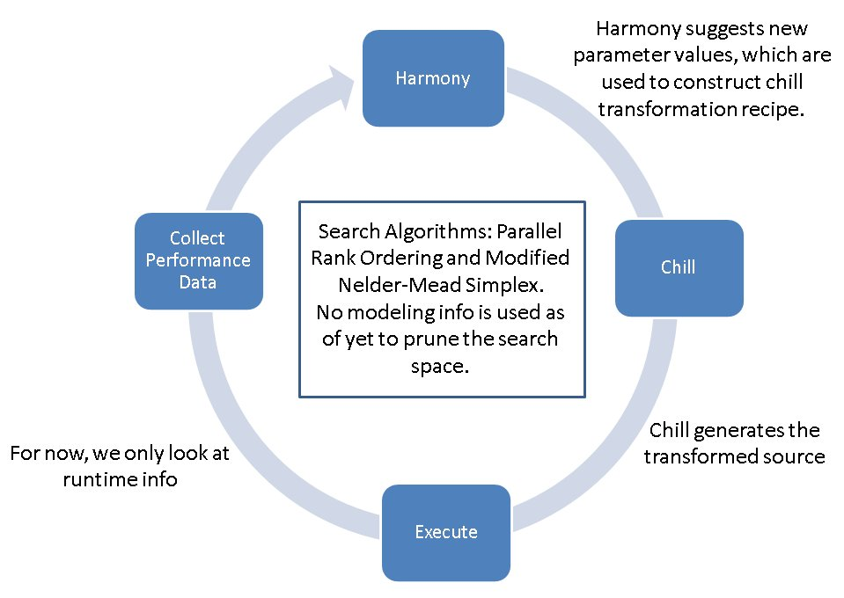
Integrating Compiler Transformations
83

Slide 84
Auto-tuning Compiler Transformations
Described as a series of Recipes
Recipes consist of a sequence of operations
Permute([stmt],order): change the loop order
Tile(stmt,loop,size,[outer-loop]): tile loop at level loop
Nnroll(stmt,loop,size): unroll stmt's loop at level loop
Datacopy(stmt,loop,array,[index]):
Make a local copy of the data
Split(stmt,loop,condition): split stmt's loop level loop into multiple loops
Nonsingular(matrix)

Slide 85
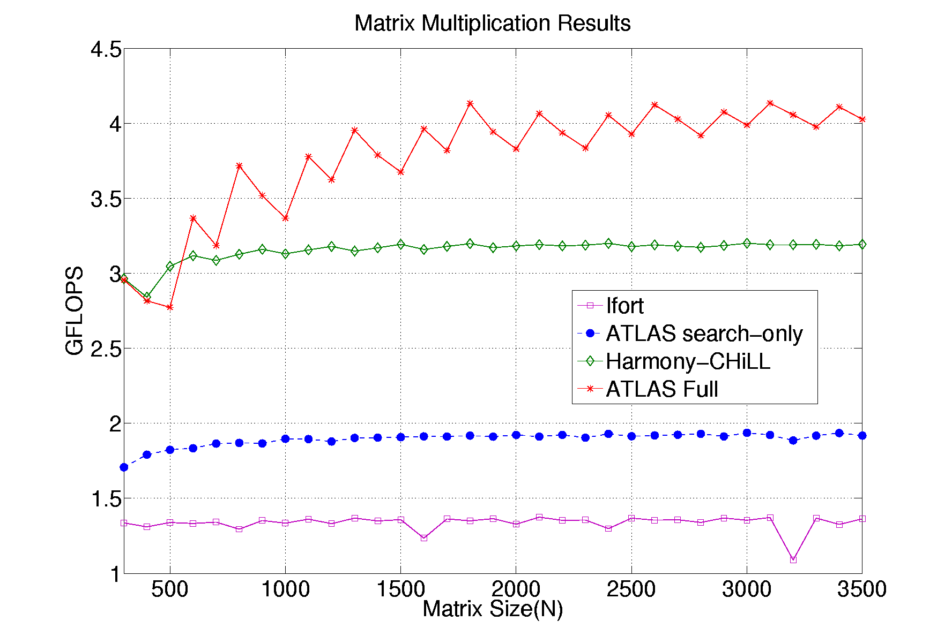
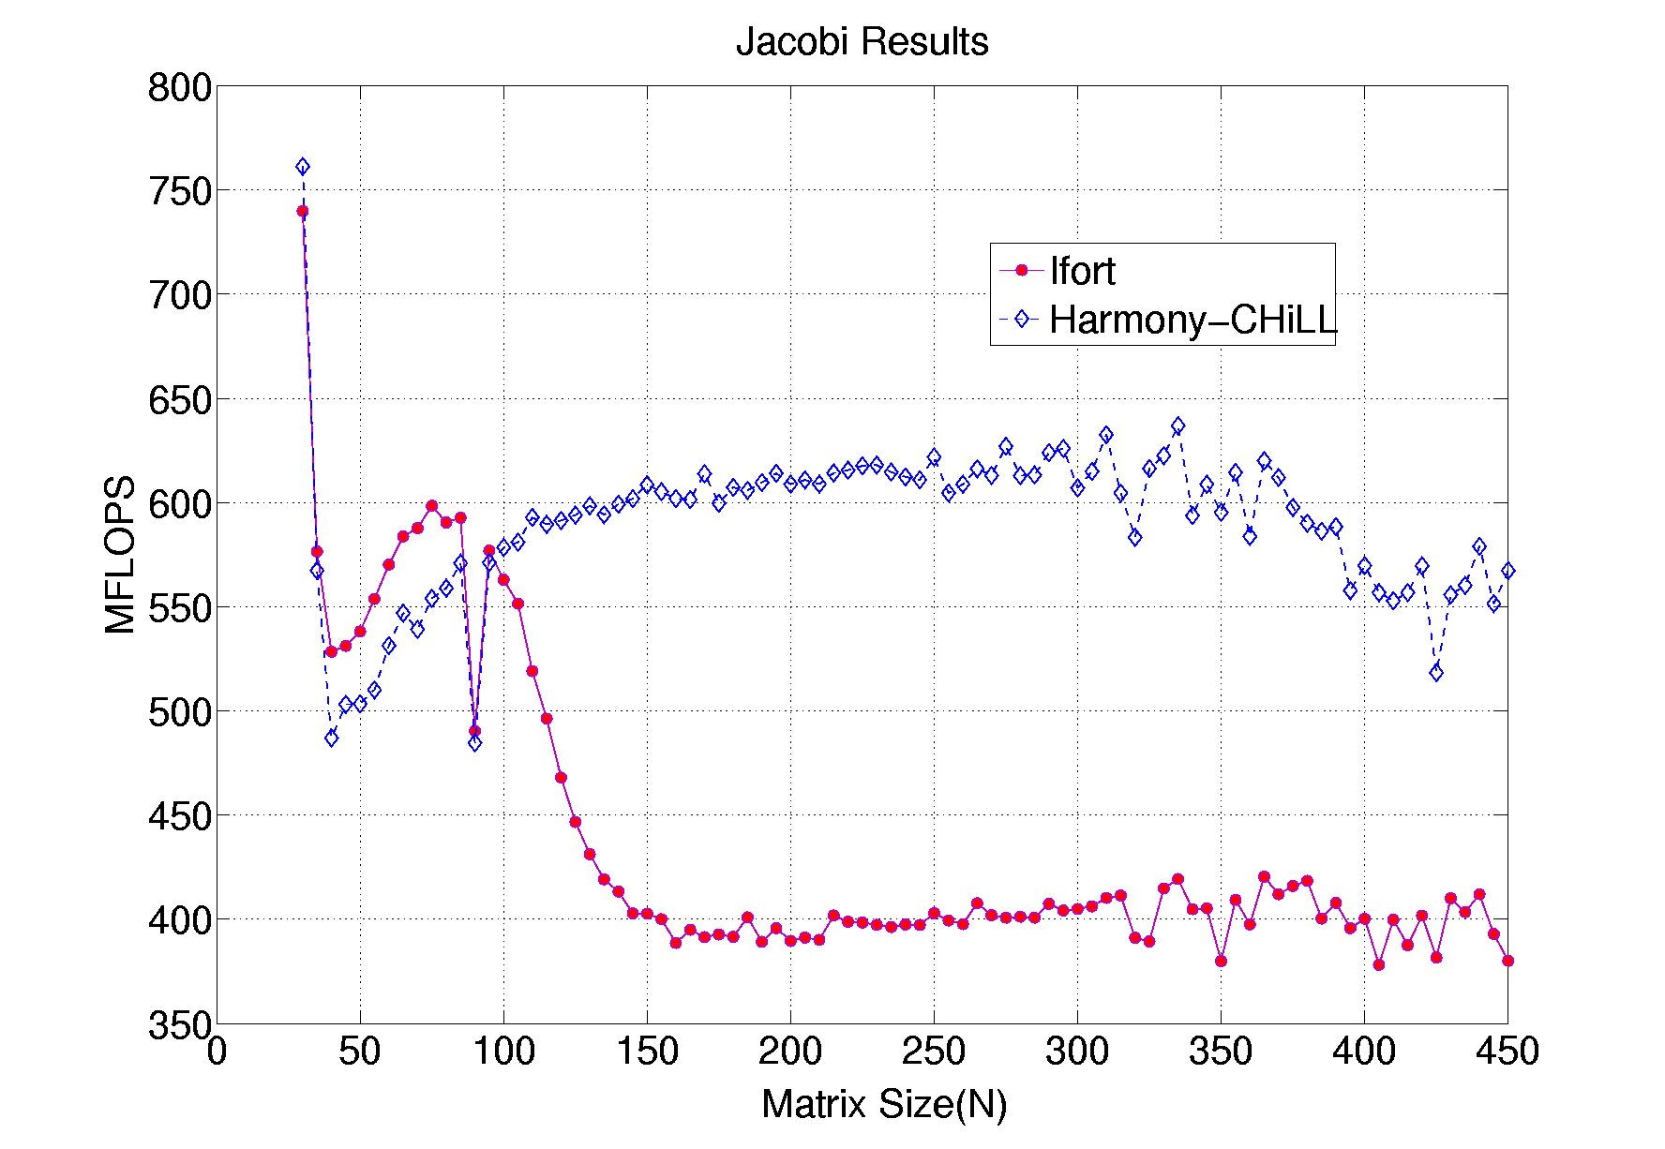
CHiLL + Active Harmony
Generate and evaluate different optimizations that would have been prohibitively time consuming for a programmer to explore manually.
Ananta Tiwari, Chun Chen, Jacqueline Chame, Mary Hall, Jeffrey K. Hollingsworth, “A Scalable Auto-tuning Framework for Compiler Optimization,” IPDPS 2009, Rome, May 2009.

Slide 86
Compiling New Code Variants at Runtime
PM₁, PM₂, … PM_{N}
Search Steps (SS)
Harmony Timeline
Active Harmony
Outlined
code-section
Code Transformation Parameters
SS₁
SS₂
SS_{N}
Code Server
Code Generation Tools
v₁s
v₂s
v_{N}s
compiler
compiler
compiler
READY Signal
Application
v₁s.so
v_{N}s.so
Application
Execution timeline
v₂s.so
Performance Measurements (PM)
stall_phase
PM₁
PM₂
PM_{N}
Notes:
Here we present our system workflow.
The horizontal arrow at the top of the figure shows the search timeline. The two horizontal arrows at the bottom represent the application timeline.
At each search step, Active Harmony will issue a request to the code-server to generate code-variants with a given set of parameters. Once the generated code-variants are compiled into a shared library, the code server sends a ready signal to the application, which then uses a simple dlopen-dlsym mechanism to load and evaluate the code. Measured performance numbers are consumed by the Harmony server.
When the new code is not ready, the application keeps running utilizing the best code-variant seen so-far. We call this phase, for lack of a better name, an stall_phase. Next we describe our proposed strategies to control the number of code-variants that we need to maintain at any given point in the search process.
86

Slide 87
Auto-Tuning for Communication
Optimize overlap
Hide communication behind as much computation as possible
Tune how often to call poll routines
Messages don’t move unless call into MPI library
Calling too often results in slowdown
Portability
No support from special hardware for overlap
Optimize local computation
Improve cache performance with loop tiling
Parameterize & Auto-Tuning
Cope with the complex trade-off regarding the optimization techniques

